Slide 1
OPERATING SYSTEMS(BCS303) Module 4

Slide 2
Memory management
The main purpose of a computer system is to execute programs.
During execution, these programs, together with the data they access, must be in main memory (at least partially)
In CPU scheduling we showed how the CPU can be shared by a set of processes.
As a result of CPU scheduling CPU utilization, as well as speed of the computer’s response to its users could be improved.
To realize this increase in performance, however, we must keep several processes in memory that is, we must have shared memory.
Dept. of ISE

Slide 3
Main Memory
Basic Hardware
Memory consists of a large array of words or bytes, each with its own address.
The CPU fetches instructions from memory according to the value of the program counter.
These instructions may cause additional loading from and storing to specific memory addresses.
A typical instruction-execution cycle first fetches an instruction from memory.
The instruction is then decoded and may cause operands to be fetched from memory. After the instruction has been executed on the operands, results may be stored back in memory.
Dept. of ISE

Slide 4
CPU can directly access only Main memory and the registers built into the processor.
There are machine instructions that take memory addresses as arguments, but none that take disk addresses.
So, any instructions in execution, and any data being used by the instructions, must be in one of these direct access storage devices.
If the data are not in memory, they must be moved there before the CPU can operate on them.
CPU Cycle Time for accessing memories
Registers :- Accessible within one cycle of the CPU clock.
Most CPUs can decode instructions and perform simple operations on register contents at the rate of one or more operations per clock tick.
Dept. of ISE

Slide 5
Main Memory:- Access may take many cycles of the CPU clock to complete
In this case, the processor normally needs to stall, since it does not have the data required to complete the instruction that it is executing.
This situation is intolerable because of the frequency of memory accesses.
Remedy:- Add fast memory between the CPU and main memory.
A memory buffer used to accommodate a speed differential, called a cache.
Dept. of ISE

Slide 6
Protection of OS from unauthorized access
The OS has to be protected from access by user processes.
In addition, user processes must be protected from one another.
This protection must be provided by the hardware.
This is done by ensuring that each process has a separate memory space.
To do this, we need the ability to determine the range of legal addresses that the process may access and to ensure that the process can access only these legal addresses.
This protection is provided by using two registers, usually a base and a limit
Dept. of ISE

Slide 7
Dept. of ISE
A base and a limit register define a logical address space.

Slide 8
A base and a limit register define a logical address space.
The base register holds the smallest legal physical memory address.
The limit register specifies the size of the range.
For example, if the base register holds 300040 and the limit register is 120900, then the program can legally access all addresses from 300040 through 420939 (inclusive).
Dept. of ISE
Hardware address protection with base and limit registers

Slide 9
The base and limit registers can be loaded only by the operating system, which uses a special privileged instruction.
Since privileged instructions can be executed only in kernel mode, and since only the operating system executes in kernel mode, only the operating system can load the base and limit registers.
This scheme allows the OS to change the value of the registers but prevents user programs from changing the registers contents.
Dept. of ISE

Slide 10
Address binding
Usually, a program resides on a disk as a binary executable file.
To be executed, the program must be brought into memory and placed within a process. Depending on the memory management in use, the process may be moved between disk and memory during its execution.
The processes on the disk that are waiting to be brought into memory for execution form the input queue.
Input queue → Select a process → Loads it into memory → Executes and accesses instructions and data from memory → Process terminates → Memory space is declared available
Dept. of ISE

Slide 11
Most systems allow a user process to reside in any part of the physical memory.
Though address space of the computer starts at 00000, the first address of the user process need not be 00000.
In most cases, a user program will go through several steps during COMPILE TIME, LOAD TIME, EXECUTION TIME before being executed.
Addresses may be represented in different ways during these steps.
Source program:- Addresses are generally symbolic (such as count)
Compiler:- Typically binds these symbolic addresses to relocatable addresses (such as “14 bytes from the belonging of this module”)
Linkage editor or Loader:- Binds the relocatable addresses to absolute addresses (such as 74014)
Each binding is a mapping from one address space to another.
Dept. of ISE

Slide 12
Binding of instructions and data to memory addresses during
Compile time. If you know at compile time where the process will reside in memory, then absolute code can be generated.
For example, if you know that a user process will reside starting at location R, then the generated compiler code will start at that location and extend up from there.
If, at some later time, the starting location changes, then it will be necessary to recompile this code.
Load time. If it is not known at compile time where the process will reside in memory, then the compiler must generate relocatable code.
In this case, final binding is delayed until load time. If the starting address changes, we need only reload the user code to incorporate this changed value.
Dept. of ISE

Slide 13
Execution time. If the process can be moved during its execution from one memory segment to another, then binding must be delayed until run time.
Special hardware must be available for this scheme to work. Most general-purpose operating systems use this method.
Dept. of ISE

Slide 14
Logical versus Physical Address Space
Logical Address:- An address generated by the CPU
Physical Address:- An address seen by the memory unit-that is, the one loaded into memory address register of the memory.
The compile-time and load-time address-binding methods generate identical logical and physical addresses.
Execution-time address binding scheme results in differing logical and physical address.
In this case, we usually refer to the logical address as virtual address.
Dept. of ISE
Dept. of ISE

Slide 15
Logical Address Space:- The set of all logical addresses generated by a program.
Physical Address Space:- The set of all physical addresses corresponding to these logical addresses.
In the execution time address binding scheme, the logical and physical address spaces differ.
The run time mapping from virtual to physical addresses is done by a hardware device called the Memory Management Unit (MMU)
Dept. of ISE

Slide 16
Dept. of ISE
Dynamic relocation using a relocation register.

Slide 17
We now have two different types of addresses:
Logical addresses (in the range 0 to max) and
Physical addresses (in the range R + 0 to R + max for a base value R)
The user generates only logical addresses and thinks that the process runs in locations 0 to max.
The user program supplies logical addresses, these logical addresses must be mapped to physical addresses before they are used.
Dept. of ISE

Slide 18
Dynamic Loading
As we have discussed so for, the entire program and all data of a process must in physical memory for the process to execute.
The size of a process is thus limited to the size of physical memory.
To obtain better memory-space utilization, we can use dynamic loading.
With dynamic loading, a routine is not loaded until it is called.
All routines are kept on disk in a relocatable load format.
The main program is loaded into memory and is executed.
When a routine needs to call another routine, the calling routine first checks to see whether the other routine has been loaded.
If not, the relocatable linking loader is called to load the desired routine into memory and to update the program’s address tables to reflect the change.
Dept. of ISE

Slide 19
Then control is passed to the newly loaded routine.
Advantages
An unused routine is never loaded.
This method is particularly useful when large amounts of code are needed to handle infrequently occurring cases.
Although the total program size may be large, the portion that is used( and hence loaded) may be much smaller.
Dept. of ISE
Dynamic loading does not require special support from the operating system.
It is the responsibility of the users to design their programs to take advantage of such a method.

Slide 20
Dynamic Linking and Shared Libraries
When a program runs, apart from its own modules, it also needs to use certain system libraries as well.
Static Linking:- System language libraries are treated like any other object module and are combined by the loader into the binary program image.
Disadvantage:- Each program on a system must include a copy of its language library (or at least the routines referenced by the program) in the executable image. This requirement both disk and main memory space.
Dynamic loading :- Checks to see whether the needed routine is already in memory.
If not, the routine is loaded into memory.
Dept. of ISE

Slide 21
The concept of dynamic linking is similar to that of dynamic loading. But here, linking rather than loading, is postponed until execution time.
Dynamically Linked Libraries
With dynamic linking, a stub is included in the image for each library routine reference.
Stub :- A small piece of code that indicates how to locate the appropriate memory resident library routine or how to load the library if the routine is not already present.
When the stub is executed, it checks to see whether the neede routine is already in memory.
Dept. of ISE

Slide 22
If not, the program loads the routine into memory.
Either way, the stub replaces itself with the address of the routine and execute the routine.
Thus, the next time that particular code segment is reached, the library routine is executed directly, incurring no cost for dynamic linking.
Dept. of ISE

Slide 23
Swapping
A process must be in memory to be executed.
A process, however, can be swapped temporarily out of memory to a backing store and then brought back into memory for continued execution.
Example
In a multiprogramming environment with a round-robin CPU-scheduling algorithm.
When a quantum expires, the memory manager will start to swap out the process that just finished and to swap another process into the memory space that has been freed.
Dept. of ISE

Slide 24
Dept. of ISE
Swapping of two processes using a disk as a backing store.

Slide 25
Memory space where Swapping happens
Normally
A process that is swapped out will be swapped back into the same memory space it occupied previously.
But it depends on the address binding method.
If binding is done at assembly or load time : The process cannot be easily moved to a different location.
If the binding is done at execution time:- The process can be swapped into a different memory space, because the physical addresses are computed during execution time.
Dept. of ISE

Slide 26
Memory space where Swapping happens
Normally
A process that is swapped out will be swapped back into the same memory space it occupied previously.
But it depends on the address binding method.
If binding is done at assembly or load time : The process cannot be easily moved to a different location.
If the binding is done at execution time:- The process can be swapped into a different memory space, because the physical addresses are computed during execution time.
Dept. of ISE

Slide 27
Backing store
Swapping requires a backing store.
The backing store is commonly a fast disk.
It must be large enough to accommodate copies of all memory images for all users.
It must provide direct access to these memory images.
The system maintains a ready queue consisting of all processes whose memory images are on the backing store or in memory and are ready to run.
Whenever the CPU scheduler decides to execute a process, it calls the dispatcher.
Dept. of ISE

Slide 28
The dispatcher checks to see whether the next process in the queue is in memory.
If it is not, and if there is no free memory region, the dispatcher swaps out a process currently in memory and swaps in the desired process.
It then reloads registers and transfers control to the selected process.
Dept. of ISE

Slide 29
Swap Time
The context switch time in a swapping system is fairly high.
Example
Let user process Size = 10MB
Transfer Rate of Backing Store = 40MB per second.
Actual transfer of the 10MB process to or from main memory takes- 10000KB/40000KB per second = ¼ second = 250milliseconds.
Assuming that no head seeks are necessary, and assuming an average latency of 8 milliseconds, the swap time = 258 milliseconds.
Since we must both swap out and swap in, the total swap time is = 258 x 2 = 516milliseconds.
Dept. of ISE

Slide 30
For efficient CPU utilization, we want the execution time for each process to be long relative to the swap time.
Thus, in a round robin CPU scheduling algorithm, for example, the time quantum should be substantially larger than 0.516seconds.
The major part of the swap time is transfer time.
The total transfer time is directly proportional to the amount of memory swapped.
Other factors that affect swapping
Dept. of ISE

Slide 31
A process must be completely idle in order to be swapped.
A process may be waiting for an I/O operation when we want to swap that process to free up memory.
If the I/O is asynchronously accessing the user memory for I/O buffers, then the process cannot be swapped.
Dept. of ISE

Slide 32
Memory Allocation
How to allocate memory?
Divide memory into several fixed sized partitions.
Each partition may contain exactly one process.
When a partition is free, a process is selected form the input queue and is loaded into the free partition.
When the process terminates, the partition become available for another process.
This is one of the simplest methods for allocating memory.
Dept. of ISE

Slide 33
Dynamic Storage Allocation Problem
How to satisfy a request of size n from a list of free partitions/holes in main memory?
Solutions:
First fit
Best fit
Worst fit
First fit
Allocate the first hole that is big enough.
Searching can start either at the beginning of the set of holes or where the previous first-fit search ended.
We can stop searching as soon as we find a free hole that is large enough.
Dept. of ISE

Slide 34
Best fit
Allocate the smallest hole that is big enough.
We must search the entire list, unless the list is ordered by size.
This strategy produces the smallest leftover hole.
Worst fit
Allocate the largest hole.
Again, we must search the entire list, unless it is sorted by size.
This strategy produces the largest leftover hole, which may be more useful than the smaller leftover hole from a best-fit approach.
Dept. of ISE

Slide 35
If all these small pieces of memory were in one big free block instead. We might be able to run several more processes.
Internal fragmentation
It occurs when memory blocks assigned to processes are bigger than what the process actually needs.
Some portion of memory is left unused, as it cannot be used by another process.
Solution: Make use of Best Fit approach for allocating memory segments to processes.

Slide 36
Solution to external fragmentation
Compaction
Shuffle the memory contents so as to place all free memory together in one large block.
Cons:
Compaction is not always possible.
If relocation is static and is done at assembly or load time, compaction cannot be done.
It is possible only if relocation is dynamic and is done at execution time.
Dept. of ISE

Slide 37
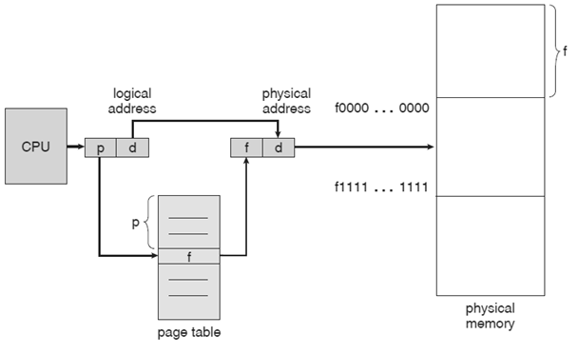
Paging
Paging is a memory-management scheme that permits the physical address space of a process to be noncontiguous.
Paging avoids the considerable problem of fitting memory chunks of varying sizes onto the backing store.
Most memory-management schemes used before the introduction of paging suffered from this problem.
Dept. of ISE

Slide 38
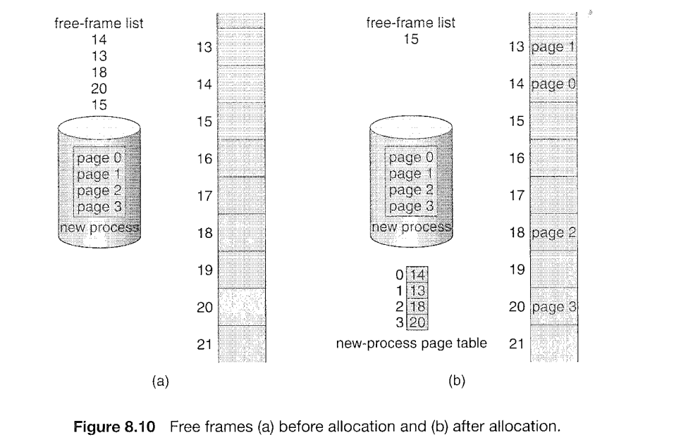
Dept. of ISE
Paging model of logical and physical memory

Slide 39
Dept. of ISE
Paging model of logical and physical memory

Slide 40
Translation of Logical Address to Physical Address using Page Table
Every address generated by the CPU is divided into two parts:
A page number (p) and A page offset (d)
page number and page offset
Dept. of ISE
Page number(p) :- Used as an index into the page table
Page Offset(d) :- The displacement within the page.

Slide 41
Dept. of ISE
Translation of Logical Address to Physical Address using Page Table

Slide 42
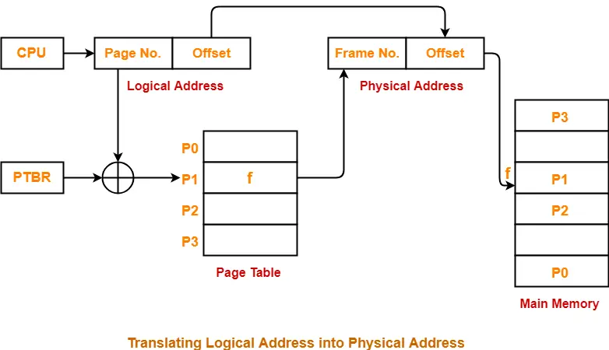
Hardware implementation of Page Table
Case 1: Implement the page table as a set of dedicated registers.
Problem: This can be used only when page table is reasonably small.
Case 2: Keep the page table in main memory and a page table base register (PTBR) points to the page table.
Problem: The time required to access a user memory location is increased as there are two memory accesses needed to access a byte (one for the page table entry, one for the byte)
Dept. of ISE

Slide 43
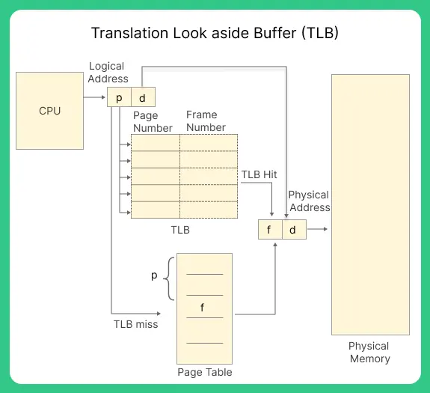
Translation Lookaside Buffer(TLB)
The TLB is associative, high speed memory.
It consists of two parts
A key
A value
When the associative memory is presented with an item, the item is compared with all keys simultaneously.
If the item is found, the corresponding value field is returned.
The search is fast.
Dept. of ISE

Slide 44
Usage of TLB with Page Table
The TLB contains only a few of the page table entries
When a logical address is generated by the CPU, its page number is presented to the TLB.
If the page number is found, its frame number is immediately available and is used to access memory → TLB Hit
If the page number is not in the TLB, a memory reference to the page table must be made. → TBL Miss
When the frame number is obtained, we can use it to access memory.
Also we add the page number and frame number to the TLB, so that they will be found quickly on the next reference.
Dept. of ISE

Slide 45
Dept. of ISE
Paging hardware with TLB.

Slide 46
Protection - Page Table Entries
Page table entries contains several information about pages which vary from OS to OS.
The most important information in a page table entry is the frame number.
The remaining information are optional.
Frame number denotes the frame where the page is present in the main memory.
The number of bits required for this depends on the number of frames in the main memory.
The Present /Absent bit specifies whether the page is present in the main memory or not.
It is also called Valid/Invalid bit.
If the page we are looking for it not present in main memory, it is called PAGE FAULT.
If the page we are looking for it is not present in main memory, the Present/Absent bit is set to 0.
Dept. of ISE

Slide 47
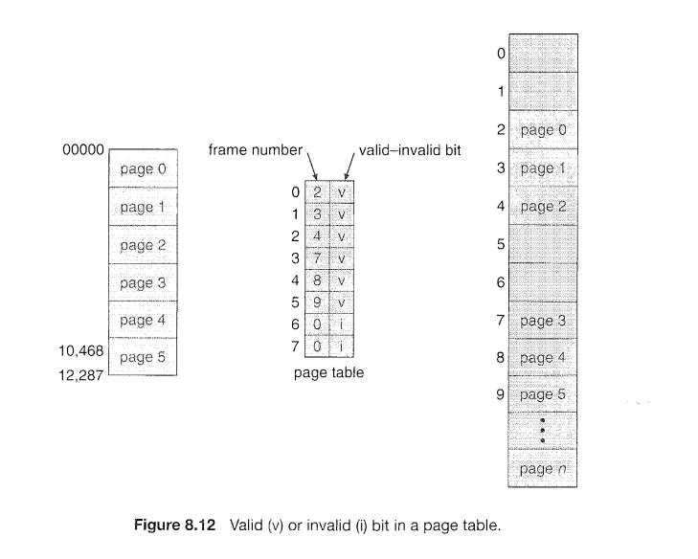
Dept. of ISE

Slide 48
The protection bit also known as Read/Write bit is used for page protection.
It specifies the permissions for read or write operations on the page.
The bit is set to 0 if only read operation is allowed.
The bit is set to 1 if both read and write operations are allowed.
The reference bit specifies whether the page has been referenced in the last clock cycle or not.
It is set to 1 when page is accessed.
The caching bit is used for enabling or disabling caching of the page.
When we need fresh data we have to disable caching so as to avoid fetching of old data from the cache.
When caching has to be disabled, this bit is set to 1. Otherwise it is set 0.
Dept. of ISE

Slide 49
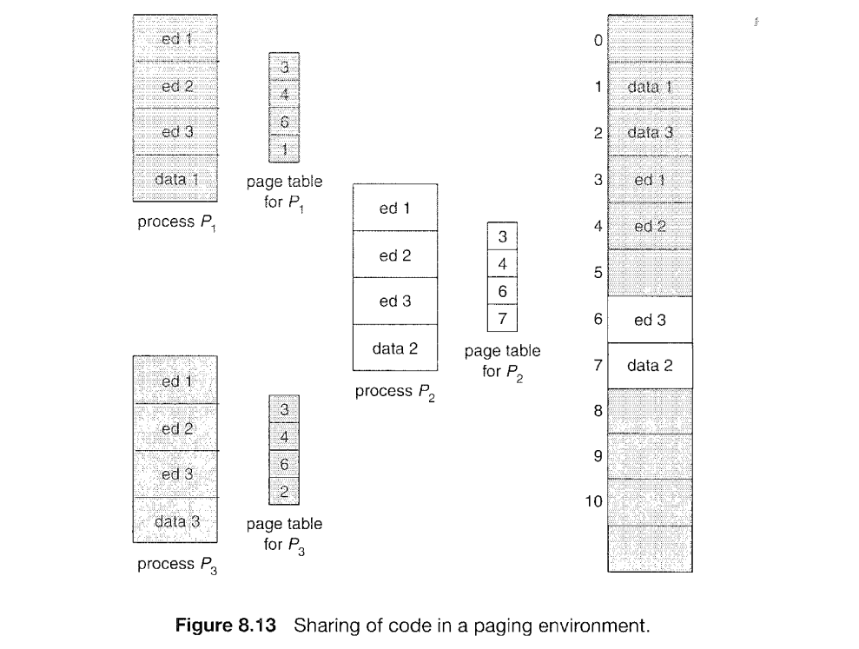
SHARED DATA
Dept. of ISE

Slide 50
The Dirty bit is also known as the Modified bit.
It Specifies whether the page has been modified or not.
If the page has been modified, then this bit is set to 1otherwise set to 0.
This bit helps in avoiding unnecessary writes to the secondary memory when a page is being replaced by another page.
Dept. of ISE

Slide 51
Shared Pages
An advantage of paging is the possibility of sharing common code.
This is particularly important in a time-sharing environment.
Consider a system that supports 40 users, each of whom executes a text editor.
If the text editor consists of 150 KB of code and 50 KB of data space,
we need, (150 x 40) + (50 x 40) = 6000 + 2000 = 8,000 KB to support the 40 users.
However, If the code is reentrant code (or pure code), it can be shared among different processes.
Code that is non self modifying code. It never changes during execution.
Thus, 2 or more processes can execute the same code at the same time.
Dept. of ISE

Slide 52
Each process has its own copy of registers and data storage to hold the data for the process’s execution. The data for two different processes will, of course, be different.
Sharing of code in a paging environment.

Slide 53
An advantage of paging is the possibility of sharing common code.
This is particularly important in a time-sharing environment.
Consider a system that supports 40 users, each of whom executes a text editor. If the text editor consists of 150 KB of code and 50 KB of data space,
we need, (150 x 40) + (50 x 40) = 6000 + 2000 = 8,000 KB to support the 40 users.
Now, if the code is shared, we need:
150 + (50 x 40) = 150 + 2000 = 2150 KB to support 40 users.
Dept. of ISE

Slide 54
Hierarchical paging
Most modern computer systems support a large logical address space (2³² to 2⁶⁴).
In such an environment, the page table itself becomes excessively large.
For example, consider a system with:
32-bit logical address space.
If the page size in such a system is 4 KB (2¹²)
Dept. of ISE

Slide 55
Then a page table may consist of up to (2³² /2¹²) = 1 million entries(approx.)
Consider each entry consists of 4 bytes
So, each process may need up to ( 4 x 1 million) bytes = 4MB of physical address space
Trying to collect a page table of this size contiguously in main memory is clearly not a good idea.
Dept. of ISE

Slide 56
Solution: Divide the page table into smaller sizes.
Multilevel Paging
Use a two level paging algorithm, in which the page table itself is also paged.
Page number Page offset
20 12 = 32 bits
Page number(p): - Used as an index into a page table
Page offset (d) :- The displacement within the page
p | d
Dept. of ISE

Slide 57
An example of logical address space division
P1 is an index into the outer page table
P2 is the displacement within the page of the outer page table.
Page offset(d) – The displacement within the page.
Dept. of ISE

Slide 58
Dept. of ISE
A two-level page-table scheme

Slide 59
Dept. of ISE
Address translation for a two-level 32-bit paging architecture.

Slide 60
Hashed Page Tables
Used for handling address spaces larger than 32 bits( or large address spaces)
Here,
The hash value is the virtual page number
Each entry in the hash table contains a linked list of elements that hash to the same location.
Each element consists of three fields:
the virtual page number,
(2) the value of the mapped page frame, and
(3) a pointer to the next element in the linked list.
Dept. of ISE

Slide 61
The algorithm works as follows:
The virtual page number in the virtual address is hashed into the hash table.
The virtual page number is compared with field 1 in the first element in the linked list.
If there is a match, the corresponding page frame (field 2) is used to form the desired physical address.
If there is no match, subsequent entries in the linked list are searched for a matching virtual page number.
Dept. of ISE

Slide 62
Dept. of ISE
Hashed page Table

Slide 63
Clustered Page Tables
This a variation of the hashed page tables which is favorable for 64- bit address.
It is similar to the hashed page tables except that each entry in the hash table refers to several pages rather than a single page.
Therefore, a single page-table entry can store the mappings for multiple physical-page frames.
Clustered page tables are particularly useful for sparse address spaces, where memory references are noncontiguous and scattered throughout the address space.
Dept. of ISE

Slide 64
Inverted Page Tables
In most Operating systems, a separate page table is maintained for each processes.
So, for ‘n’ number of processes, there will be ‘n’ number of page tables.
For large processes, there would be many pages and for maintaining information about these pages, there would be too many entries in their page tables which itself would occupy a lot of the memory.
Hence memory utilization is not efficient as a lot of memory is wasted in maintaining page tables itself.
Solution to this problem: Use Inverted Page Tables
Dept. of ISE

Slide 65
An inverted page table has one entry for each real page (or frame) of memory.
Each entry consists of the virtual address of the page stored in that real memory location, with information about the process that owns that page.
Thus, only one page table is in the system, and it has only one entry for each page of physical memory.
Each virtual address in the system consists of a triple
<process-id, page-number, offset>.
Each inverted page-table entry is a pair <process-id, page-number>
Dept. of ISE

Slide 66
When a memory reference occurs, part of the virtual address, consisting of <process-id, page number>, is presented to the memory subsystem.
The inverted page table is then searched for a match.
If a match is found-say, at entry i-then the physical address <i, offset> is generated.
If no match is found, then an illegal address access has been attempted.
Dept. of ISE

Slide 67
Virtual Memory
So far we have discussed various memory management strategies used in computer systems.
Purpose ?
Keep many processes in memory simultaneously to allow multiprogramming.
However,
They tend to require that an entire process be in memory before it can execute.
Hence the processes that can be loaded on to the main memory is often limited by the size of the main memory.
Dept. of ISE

Slide 68
Dept. of ISE
Inverted page table.

Slide 69
Advantages of Inverted Page Tables:
Reduces memory usage.
Disadvantages of Inverted Page Tables:
Increased search time as inverted page table is sorted by physical address, but lookups occur on virtual addresses. The whole table might to be searched for a match.
Difficulty in implementing shared memory.
Dept. of ISE

Slide 70
Segmentation
Segmentation is another non – contiguous memory allocation technique like paging.
Unlike paging, in segmentation, the processes are not divided into fixed size pages.
Instead, the processes are divided into several modules called segments which improves the visualization for the users.
So, here , both secondary memory and main memory are divided into partitions of unequal sizes.
Dept. of ISE

Slide 71
Dept. of ISE
User's view of a program.

Slide 72
A logical address space is a collection of segments.
Each segment has a name and a length.
The addresses specify both the segment name and the offset within the segment.
The user therefore specifies each address by two quantities: A segment name and An offset.
Dept. of ISE

Slide 73
While paging – the user specifies only a single address, which is partitioned by the hardware into a page number and an offset, all invisible to the programmer.
For simplicity of implementation, segments are numbered and are referred to by a segment number, rather than by a segment name.
Thus, a logical address consists of a two tuple:
<segment-number, offset>.
Dept. of ISE

Slide 74
Segment Table
We must define an implementation to map two dimensional user defined addresses into one dimensional physical addresses.
This mapping is done by using a segment table.
Each entry in the segment table has a segment base and a segment limit.
The segment base contains the starting physical address where the segment resides in memory, whereas the segment limit specifies the length of the segment.
Dept. of ISE
 | Limit | Base
Segment 0 | 1000 | 1400
Segment 1 | 400 | 6300
Segment 2 | 400 | 4300
Segment 3 | 1100 | 3200
Segment 4 | 1000 | 4700

Slide 75
Dept. of ISE
Example of segmentation.

Slide 76
Segmentation Hardware
Although in segmentation the user can now refer to objects in the program by a two dimensional address, the actual physical memory is still, of course, a one dimensional sequence of bytes.
Thus, we must define an implementation to map two dimensional user defined addresses into one dimensional physical addresses.
This is done with the help of a segment table.
Dept. of ISE

Slide 77
A logical address consists of two parts:
A segment number, ‘s’, and an offset into that segment, ‘d’.
The segment number is used as an index to the segment table.
The offset d of the logical address must be between 0 and segment limit.
If it is not, we trap to the OS(logical addressing attempt beyond, end of segment)
When a offset is legal, it is added to the segment base to produce the address in physical memory of the desired byte
Dept. of ISE

Slide 78
.
Dept. of ISE
Segmentation hardware.

Slide 79
Dept. of ISE
Example: Reference to byte 53 of segment2 mapped to onto location 4300 + 53 = 4353
Reference to byte 852 of segment 3 mapped to onto location 3200 + 852 = 4052
Reference to byte 1222 of segment 0 would result in a trap to the OS, as this segment is only 1000 bytes long.

Slide 80
Virtual Memory Management
Dept. of ISE

Slide 81
Why Virtual Memory
Virtual memory is a storage scheme where secondary memory can be treated as though it is a part of main memory and large processes can be stored in it. Only the part of the process that is actually needed for execution will be loaded on to the actual main memory.
An examination of real programs shows that:
Programs often have code to handle unusual error conditions. Since theses errors seldom, if ever, occur in practice, this code is almost never executed.
Arrays, list, and ta tables are often allocated more memory than they actually need. An array may be declared 100 by 100 elements, even thiugh it is seldom larger than 10 by 10 elements.
Dept. of ISE

Slide 82
An assembler symbol table may have room for 3000 symbols, although the average program has less than 200 symbols.
Dept. of ISE
Diagram showing virtual memory that is larger than physical memory.

Slide 83
Benefits of being able to execute a program that is only partially in memory
A program would no longer be constrained by the amount of physical memory that is available. Users would be able to write programs for an extremely large virtual address space, simplifying the programming task.
Because each user program could take less physical memory, more programs could be run at the same time, with a corresponding increase in CPU utilization and throughput but with no increase in response time or turnaround time.
Less I/O would be needed to load or swap each user program into memory, so each user program would run faster.
Dept. of ISE

Slide 84
Running a program that is not entirely in memory would benefit both the system and the user.
Virtual memory involves the separation of logical memory sa perceived by users from physical memory.
This separation, allows an extremely large virtually memory to be provided for programmers when only a smaller physical memory is available.
Dept. of ISE

Slide 85
Demand Paging
How can an executable program be loaded from disk to memory?
Approach-1:
Load the entire program in physical memory at program execution time.
Problem:
We may not initially need the entire program in memory. Consider a program that starts with a list of available options from which the user is to select. Loading the entire program into memory results in loading the executable code for all options, regardless of whether an option is ultimately selected by the user or not.
Dept. of ISE

Slide 86
Approach – 2:
Load pages only as they are needed. Pages are only loaded when they are demanded during program execution. Pages that are never accessed are thus never loaded into physical memory. This is called Demand Paging.
A demand-paging system is similar to a paging system with swapping where processes reside in secondary memory (usually a disk).
When we want to execute a process, we swap it into memory.
Rather than swapping the entire process into memory, however, we use a lazy swapper.
A lazy swapper never swaps a page into memory unless that page will be needed.
Dept. of ISE

Slide 87
Since we are now viewing a process as a sequence of pages, rather than as one large contiguous address space, use of the term swapper is technically incorrect.
So, in connection with Demand Paging we will use the term Pager.
A swapper manipulates entire processes, whereas a pager is concerned with the individual pages of a process.
Dept. of ISE

Slide 88
Dept. of ISE
Transfer of a paged memory to contiguous disk space.

Slide 89
Hardware Implementation of Demand Paging
In Demand paging, pages are only loaded when they are demanded during program execution. Pages that are never accessed are thus never loaded into physical memory.
The pager takes care of swapping pages in and out of the memory.
How can the hardware implementation be done to distinguish between pages that are in memory and the pages that are on the disk?
Dept. of ISE

Slide 90
We can make use of the Present/Absent Bit or Valid/Invalid Bit.
If the Bit is set to ‘VALID’ – The page is both legal and in memory.
If the Bit is set to ‘INVALID’ – The page is either not in the logical address space off the process or is valid but is currently on the disk.
Page Table Entries
Page Table Entries for pages that are brought to memory. – will be set as usual
Page-table entries for a pages that are not currently in memory – will be either marked as invalid or contains the address of the page on disk.
Dept. of ISE

Slide 91
Dept. of ISE
Page table when some pages are not in main memory.

Slide 92
Page Fault
What would happen if a process tries to access a page that is not present in memory?
This scenario is known as a page fault
Access to a page marked invalid causes a page fault trap.
The paging hardware, in translating the address through the page table, will notice that the invalid bit is set, causing a trap to the OS.
Dept. of ISE

Slide 93
A page fault may occur at any memory reference
If the page fault occurs on the instruction fetch, we can restart by fetching the instruction again.
If a page fault occurs while we are fetching on operand, we must fetch and decode the instruction again and then fetch the operand.
Dept. of ISE

Slide 94
Consider a three address instruction for adding the contents of A to B and placing the result in C
Fetch and decode the instruction(ADD)
Fetch A
Fetch B
Add A and B
Store the sum in C.
Assume that C is a page which is not yet present in memory.
Then a page fault will occur when trying to store the sum in C.
Dept. of ISE

Slide 95
In this case, we have to get the desired page, bring it into memory, correct the page table and restart the instruction.
While restarting we have to
Fetch the instruction again
Decode it again
Fetch the 2 operands A and B again
Perform the addition again and
Store the sum in C
Dept. of ISE

Slide 96
The procedure for handling this page faults
We check an internal table (usually kept with the process control block) for this process to determine whether the reference was a valid or an invalid memory access.
If the reference was invalid, we terminate the process.
If it was valid, but we have not yet brought in that page, we now page it in.
We find a free frame (by taking one from the free-frame list, for example).
Dept. of ISE

Slide 97
5. We schedule a disk operation to read the desired page into the newly allocated frame.
6. When the disk read is complete, we modify the internal table kept with the process and the page table to indicate that the page is now in memory.
7. We restart the instruction that was interrupted by the trap.
The process can now access the page as though it had always been in memory.
Dept. of ISE

Slide 98
Dept. of ISE
Handling a page fault.

Slide 99
Performance of Demand Paging
A computer system’s performance can be significantly affected by Demand Paging.
Let us see how, by taking a look at the Effective Access Time.
The Memory Access Time (ma) for most systems usually ranges from 10 to 200ns.
If there are no page faults, the Effective Access Time will be equal to the Memory Access Time.
Dept. of ISE

Slide 100
But what if a page fault occurs?
Let p be the probability of a page fault (0 <=p<=1).
Effective access time = (1 - p) x ma + p x page fault time
Time spent for normal memory access
Time spent for handling page fault
Dept. of ISE

Slide 101
The sequence that occurs when a page fault happens:
1. Trap to the operating system.
2. Save the user registers and process state.
3. Determine that the interrupt was a page fault.
4. Check that the page reference was legal and determine the location of the page on the disk.
5. Issue a read from the disk to a free frame:
a. Wait in a queue for this device until the read request is serviced.
b. Wait for the device seek and / or latency time.
c. Begin the transfer of the page to a free frame.
Dept. of ISE

Slide 102
6. While waiting, allocate the CPU to some other user (CPU scheduling, optional).
7. Receive an interrupt from the disk [I/0 subsystem (I/O completed).
8. Save the registers and process state for the other user (if step 6 is executed).
9. Determine that the interrupt was from the disk.
10. Correct the page table and other tables to show that the desired page is now in memory.
11. Wait for the CPU to be allocated to this process again.
12. Restore the user registers, process state, and new page table, and then resume the interrupted instruction.
Dept. of ISE

Slide 103
Not all the steps shown in the previous slide are necessary in every case.
But in all cases we will face three major components of the page fault service time:
Service the page – fault interrupt.
Read in the page.
Restart the process
1 and 3 may take 1 to 100 microseconds each
2 can take close to 8 milliseconds
We can consider an average page fault handling time of 8 ms and a memory access time of 200ns.
Dept. of ISE

Slide 104
Effective access time = (1 - p) x ma + p x page fault time
= (1-p) x ma + p (8ms)
= (1-p) x (200) + p x 8000000
= 200-200p + 8000000p
= 200 +7999800p
The effective access time is directly proportional to the page fault rate.
If one access out of 1000 causes a page fault, then,
Effective access time = 200 + (7999800 x 1/1000) = 8199.8 = 8.2microseconds
Dept. of ISE

Slide 105
Copy-on-write
Copy on write(CoW) is a technique that is used for sharing virtual memory or pages. It is mostly used in conjunction with the fork() system call that is used for creating child Process.
fork() system call creates a child process as a duplicate of its parent.
Instead of doing this we can optimize this method by making the parent and child processes to store the common pages and only create a copy when one of the processes (either child or parent) wants to write (modify) a page.
This technique is called Copy on write.
Dept. of ISE

Slide 106
Dept. of ISE
Before process 1 modifies page C.

Slide 107
Dept. of ISE
After process 1 modifies page C.

Slide 108
Only pages that can be modified need be marked as copy on write
Pages that cannot be modified (pages containing executable code) can be shared by the parent and child.
Dept. of ISE

Slide 109
Page Replacement
Page replacement is the technique of swapping out pages from physical memory when there are no more free frames available, in order to make room for other pages which has to be loaded to the physical memory.
If a process wants to use/access a page which is not present in physical memory, it will cause a page fault.
So, that page has to be now loaded into memory.
.
Dept. of ISE

Slide 110
Dept. of ISE
Need for page replacement

Slide 111
But if there are no free frames available to load that page, what should we do that?
1. We look for an occupied frame that is not being used currently.
2. We free that frame by writing its contents to the swap space.
3. We update the page tables to indicate that the page is now no more in memory.
4. We load the page of the process that caused the page fault to occur into the freed frame
Dept. of ISE

Slide 112
Steps:
Find the location of the page to be loaded on the disk.
If there is a free frame, use that frame and load the page into that frame.
If there are no free frames, use a page replacement algorithm to select a victim frame.
Write the victim frame to the disk and change the page and frame tables accordingly.
Read the desired page into the newly freed frame and change the page and frame tables.
Restart the user process.
Dept. of ISE

Slide 113
Dept. of ISE
Page Replacement

Slide 114
Page fault service time when no frames are free
If no frames are free, two page transfers (one out and one in) are required.
This doubles the page-fault service time and increases the effective access time accordingly.
How can we reduce this?
We can make use of the Modify bit or Dirty bit.
The modify bit is set when a page has been modified.
Dept. of ISE

Slide 115
So, when page replacement has to be done on a page which is present in memory.
If modify bit is set – That means the page has been modified and we need to write that to the disk.
If the modify bit is not set – That means the page has not been modified and is the same as the copy which is already present in the disk.
In this case, we don’t have to overwrite this page on the disk, thus reducing the overhead and the effective access time accordingly.
Dept. of ISE

Slide 116
FIFO page replacement
The first-in, first-out (FIFO) algorithm is the simplest page replacement algorithm.
When page replacement has to be done, the oldest page in memory is chosen to be swapped out.
How to maintain a record of the time that pages were brought into memory in order to figure out which is the oldest one?
We don’t have to strictly record the time.
Instead we can use a FIFO queue that can hold all the pages that are in memory.
When replacement has to be done, we choose the page at the head of the queue to be swapped out of memory.
When a new page is loaded into memory, we add it to the tail of the queue.
Dept. of ISE

Slide 117
Consider the reference string
7,0,1,2,0,3,0,4,2,3,0,3,2,1,2,0,1,7,0,1 where each value represents a page.
Let us say we have 3 frames in memory
Also, let us consider a queue that can hold all the pages that are loaded in memory
Dept. of ISE
Head
Tail
P3 | P2 | P1

Slide 118
Dept. of ISE
FIFO page-replacement algorithm

Slide 119
Belady’s Anomaly
General Expectation about relation between number of frames in memory and number of page faults.
With more number of page frames there will be lesser page faults
As the number of frames increases, the number page faults drops to the minimal level.
Adding physical memory increases the number frames
Dept. of ISE

Slide 120
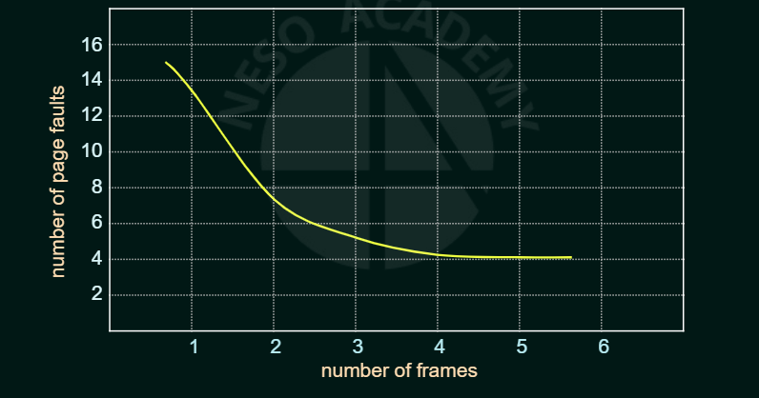
Belady’s Anomaly
With more number of page frames there will be lesser page faults.
As the number of frames increases, the number of faults drops to some minimal level.
Adding physical memory increases the number of frames.
Dept. of ISE

Slide 121
Consider the reference string
1,2,3,4,1,2,5,1,2,3,4,5
Where each value represents a page
Lets us say we have 3 frames in memory
Let us use the FIFO page replacement and find the number of page faults that would occur in this case.
Dept. of ISE

Slide 122
1
2
3
4
1
2
5
1
2
3
4
5
1
1
2
1
2
3
4
2
3
4
1
3
4
1
3
5
1
2
5
1
2
5
1
2
5
3
2
5
3
4
5
3
4
F
F
F
F
F
F
F
F
F
Dept. of ISE
9 page faults

Slide 123
Consider the reference string
1,2,3,4,1,2,5,1,2,3,4,5
Where each value represents a page
Lets us say we have 4 frames in memory
Let us use the FIFO page replacement and find the number of page faults that would occur in this case.
Dept. of ISE

Slide 124
2
1
2
1
3
3
4
4
3
5
3
5
1
2
1
2
1
1
2
2
4
5
1
1
2
1
2
3
1
2
3
4
1
2
3
4
1
2
3
4
5
2
3
4
5
1
3
4
5
1
2
4
5
1
2
3
4
1
2
3
4
5
2
3
F
F
F
F
F
F
F
F
F
F
F
Dept. of ISE
10 page faults

Slide 125
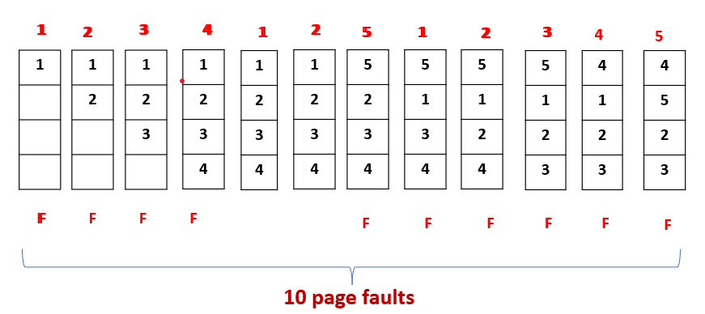
1
2
3
4
1
2
5
1
2
3
4
5
1
1
2
1
2
3
4
2
3
4
1
3
4
1
3
5
1
2
5
1
2
5
1
2
5
3
2
5
3
4
5
3
4
9 page faults when there are 3 frames
F
F
F
F
F
F
F
F
F
Dept. of ISE
10 page faults when there are 4 frames

Slide 126
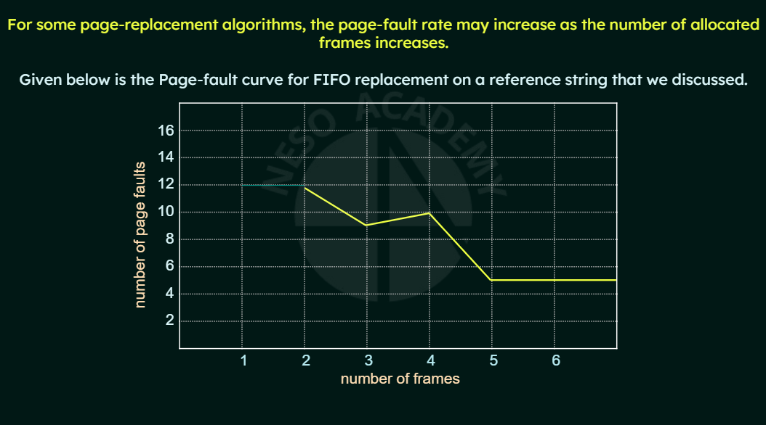
Dept. of ISE

Slide 127
Optimal Page Replacement
An Optimal page replacement algorithm has the lowest page fault rate of all algorithms.
It will never suffer from belady’s anomaly.
It guarantees the lowest possible page fault rate for a fixed number of frames.
Dept. of ISE

Slide 128
Dept. of ISE
With only nine page faults, optimal replacement is much better than a FIFO algorithm, which resulted in fifteen faults. Unfortunately, the optimal page-replacement algorithm is difficult to implement, because it requires future knowledge of the reference string.

Slide 129
LRU Page Replacement
Least recently used algorithm
It associates with each page the time of that page’s last use.
When a page must be replaced, LRU chooses the page that has not been used for longest period of time.
It is almost like the optimal page replacement algorithm looking backward in time, rather than forward.
Dept. of ISE

Slide 130
.
Dept. of ISE
The LRU algorithm produces 12 faults.
The LRU Page Replacement Algorithm is generally considered a good algorithm and is used frequently.

Slide 131
Implementation of LRU Page Replacement
An LRU page replacement algorithm may require substantial hardware assistance.
The problem is How to keep track of the pages that were least recently used?
There are two ways we can implement this:
By using counters
By using a stack
Dept. of ISE

Slide 132
Counter Implementation
With each page table entry, we associate a time of use field and add a logical clock or counter to the CPU.
The clock is incremented for every memory reference.
Whenever a reference to a page is made, the contents of the clock register are copied to the time of use field in the page table entry for that page.
Hence, we always have the “time” of the last reference to each page.
We replace the page with the smallest time value.
Dept. of ISE

Slide 133
Stack Implementation
Maintain a stack of page numbers.
Whenever a page is referenced, it is removed from the stack and put on the top.
Hence, the most recently used page is always at the top of the stack and the least recently used page is always at the bottom.
Since, entries must be removed from the middle of the stack, it is best to implement this approach by using a doubly linked list with a head and tail pointer.
Dept. of ISE

Slide 134
Additional-Reference-Bits Algorithm
LRU Approximation age Replacement
Only a few computer systems provide the necessary hardware support for LRU Page Replacement
Some systems provide no hardware support at all and we end up using other algorithms like FIFO.
However, many systems provide support for LRU in the form of a reference bit.
The reference bit( which is associated with each entry in the page table) for a page is set by the hardware whenever that page is referenced.
Dept. of ISE

Slide 135
Steps:
Initially the OS sets all the reference bits for all the pages to ‘0’.
Whenever a page is referenced, the hardware sets the reference bits to ‘1’.
By checking these reference bits we can tell which pages have been used and which haven’t been used.
But, we cannot determine the order of use.
Dept. of ISE

Slide 136
Additional Reference Bits Algorithm
Used to get an idea of the ordering information of by recording the reference bits at regular intervals
How is it done?
We keep an 8 bit byte for each page in a table in memory.
At regular intervals(say, every 100 ms), a timer interrupt transfers control to the OS.
The OS shifts the reference bit for each page into the high order bit of its 8 bit byte, shifting the other bits right by 1 bit and discarding the low order bit.
These 8 bit shift registers contain the history of page use for the last eight time periods.
Dept. of ISE

Slide 137
Second-Chance Algorithm
LRU Approximation Page Replacement
It is basically a FIFO replacement algorithm but with an additional feature.
When a page has been selected, we check its reference bit.
If reference bit = 0 → we replace the page.
If reference bit = 1 → we give a second chance to that page and move on to the next.
When a page gets a second chance, its reference bit is reset to ‘0’ and its arrival time is reset to the current time.
So, if a page is given a second chance, it is not replaced until all other pages are either replaced or given their own second chance.
Also, if a page is frequently used, its reference bit will mostly be set(1) and hence, it will never be replaced.
Dept. of ISE

Slide 138
Dept. of ISE
Second-chance (clock) page-replacement algorithm.

Slide 139
Enhanced Second-Chance Algorithm
LRU Approximation Page Replacement
This is an enhancement of the second chance algorithm.
How?
Here we consider the reference bit and the modify bit as an ordered pair.
Reference bit is set when a page has been referenced.
Modify bit is set when a page has been modified.
Dept. of ISE

Slide 140
Here we can have four possible cases
(0,0) , (0,1), (1,0) , (1,1)
Reference bit | Modify bit | What it implies | Remarks
0 | 0 | The page was neither used recently nor modified | Best page to replaced
0 | 1 | The page was not used recently, but it has been modified | Not the best page to be replaced, as we will have to write this page to the disk when replacement is done.
1 | 0 | The page was used recently but not modified | There are chances that this page will be used again soon
1 | 1 | The page was used recently and also has been modified | There are chances that this page will be used again soon and also we will have to write this page to the disk if we choose to replace this page
Dept. of ISE

Slide 141
Counting Based Page Replacement
Maintain a counter that keeps a count of the number of references made to each page
Using the counter we formulate the following schemes
Least Frequently Used (LFU) Page Replacement Algorithm
Most Frequently Used (MFU) Page Replacement Algorithm
Dept. of ISE

Slide 142
Least Frequently Used (LFU) Page Replacement Algorithm
Counter – Keeps a count of the number of refrences made to each page
Pages which are least used – will have lesser counts
Pages which are frequently used – will have greater counts
Replace the page with least count
Problem: Pages that wrer heavily used during the initial phase of processes would have higher counts and would remain in memory though they may not be needed further.
Solution: Shift the counts right by 1 bit at regular intervals, forming an exponentially decaying average usage count.
Dept. of ISE

Slide 143
Most Frequently Used (MFU) Page Replacement Algorithm
Counter – Keeps a count of the number of refrences made to each page
Pages which are least used – will have lesser counts
Pages which are frequently used – will have greater counts
Based on the argument that the page with the smallest count was probably just brought in and is yet to be used.
Do not replace the page with the least count.
Dept. of ISE

Slide 144
Both LFU and MFU algorithms are
Expensive to implement and they also
Do not approximate Optimal Page Replacement well
Hence they are not usually used.
Dept. of ISE

Slide 145
Page Buffering Algorithm
Maintain a pool of free frames
When a Page fault occurs:
A victim frame is chosen
The desired page is loaded into a frame from the free frames pool
This happens before the victim page is swapped out.
Once the victim page is swapped out and written to the disk, the victim frame will be added to the free frames pool.
This allows the process to restart as soon as possible, without waiting for the victim page to be written out.
Dept. of ISE

Slide 146
An expansion of this idea
Maintain a pool of modified pages.
Whenever the paging Device is idle:
A modified page is selected and is written to the disk.
Its modify bit is then reset.
Why is this done?
This increases the probability that a page will be clean when it is selected for replacement and will not need to be written back to the disk again.
Dept. of ISE

Slide 147
Allocation of frames
How do we allocate to various processes the fixed amount of free memory that is available?
Example:
In a single User System:
Consider Memory Size = 128KB.
Page Size = 1 KB
So, number of frames = 128
Suppose OS uses 30KB
Dept. of ISE

Slide 148
Frames remaining for user processes = 128 – 30 = 98
These 98 frames would be available in the free frames list.
If demand Paging is used:
The first 98 page faults would get all free frames from the list.
When the free frames are exhausted, a page replacement algorithm would be used to replace a page from the occupied list of 98 with the 99th page.
Dept. of ISE

Slide 149
Minimum Number of frames
Constraints for allocation of frames:
Unless there is page sharing, we cannot allocate more than the total number of available frames.
A minimum number of frames should be allocated to each process.
Performance: As the number of frames allocated to a process decreases, the page fault rate increases.
There should be enough frames to hold all the different pages that any single instruction can reference.
Suppose in a one level indirect addressing, a load instruction on page 15 refers to an address on page 1, which is an indirect reference to page 22 – Here 3 frames are needed per process.
Dept. of ISE

Slide 150
Allocation Algorithms
Frame allocation algorithms would help us in determining how many frames should be allocated to different processes in a multi processing environment
The three most common allocation algorithms
Equal Allocation
Proportional Algorithm
Priority Algorithm
Dept. of ISE

Slide 151
Equal Allocation
The frames are equally distributed among the processes.
If we have m number of frames
If we have n number of processes
We allocate m/n frames to each process.
Example:
Number of frames = 98
Number of processes = 5
Each process gets = 98/5 = 19 frames
Dept. of ISE

Slide 152
The remaining 3 frames are kept as free frame buffer pool.
Problem : The memory requirement of processes are not the same.
Example : In a system with 64 free frames where frame size = 1 KB , say we have just 2 processes P1 = 10KB and P2 = 127 KB we allocate 64/2 = 32 frames to both processes.
But P1 needs only 10 frames and hence the remaining 32-10 = 22 frames are wasted.
Dept. of ISE

Slide 153
Proportional Allocation
The frames are distributed among the processes according to their sizes
Let,
m be the number of frames
S_{i} be size of process p_{i}
S = Ʃ s_{i}
Number of frames allocated to p_{i} = a_{i}
Where
a_{i} = s_{i}/S * m
Dept. of ISE

Slide 154
Example : In a system with 64 frames where frame size = 1 KB, say we have just 2 processes P1 = 10 KB and P2 = 127 KB
Here
m = 64
S₁ = 10 KB
S₂ = 127 KB
S = S₁ + S₂ = 10 + 127 = 137 KB
Frames allocated to P1 = a₁ = s₁/S * m = 10/137 * 64 = 5
Frames allocated to P2 = a₂ = s₂/S * m = 127/137 * 64 = 59
Dept. of ISE

Slide 155
Priority Allocation
The frames are distributed among the processes according to their priorities.
Here we implement a proportional allocation scheme using priorities or a combination of size and priorities rather than just size of the processes.
So, we allocate more frames to processes with higher priorities so as to speed up their execution.
Dept. of ISE

Slide 156
Global versus Local Allocation
Page replacement algorithms can be classified into two broad categories
Global Replacement
Local replacement
This is another important factor in deciding the way frames are allocated to different processes.
Dept. of ISE

Slide 157
Global Allocation
In global replacement:
When a page fault occurs:
Processes are allowed to select replacement frames from the set of all frames even if the frames are allocated to some other processes.
Example: If process P1 is of higher priority than the process P2 and P3, and if all frames of P1 are full and it now needs one more frame due to a page fault, it could take a frame that is allocated to either P2 or P3.
Problem: Processes cannot control their own page fault rate.
Dept. of ISE

Slide 158
Local Allocation
In local replacement:
When page fault occurs:
Processes are allowed to select replacement frames only from the set of frames that is particularly allocated to them.
Example: If all frames of P1 are full and it now needs one more frame due to a page fault, it can perform a replacement only with one of its own frames.
Problem: Memory utilization is not good as compared to global replacement.
Dept. of ISE

Slide 159
THANK YOU
Dept. of ISE

